Slide 1
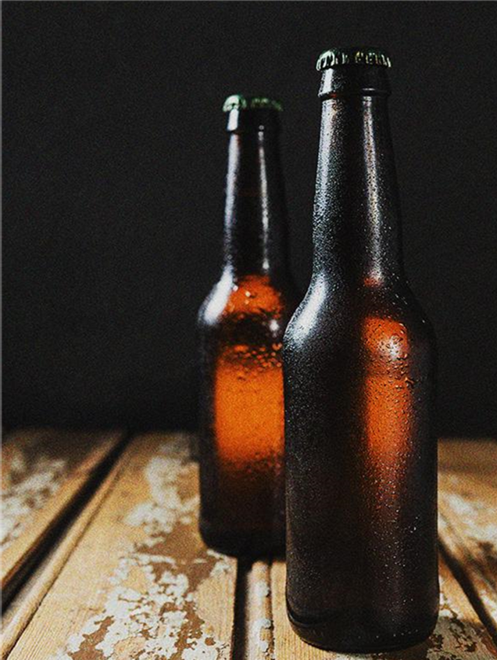
BREWED AWAKENING
CHEERS!
CHEERS!
CHEERS!

Slide 2
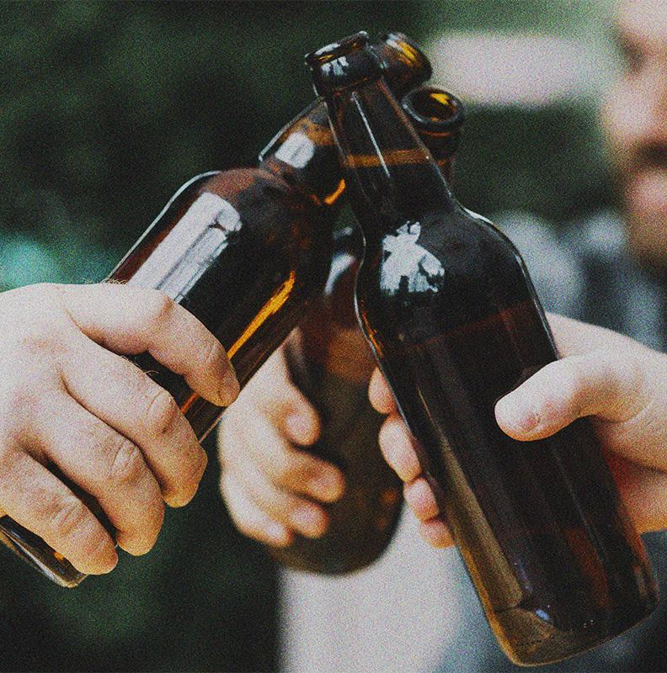
Happy Hour Heroes
Abel Paul Thomas
Divya Jain
Sean Alcid
Shuang Lu
Siddhesh Mishra
Sneha Murali
Tirth Shah
Venkatesh Tripuraneni

Slide 3
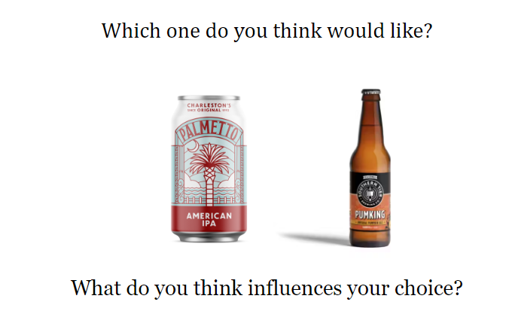

Slide 4

Table of Contents
01
02
03
04
CHEERS!
CHEERS!
CHEERS!
Introduction
Data Processing
Data Set
Questions of Interest
Data Cleaning
Data Clustering
Data Analysis
Conclusion
Summary
Significance
Future Scope
Correlation Heatmap
Distribution of Review Scores
Distribution of Beer Style

Slide 5
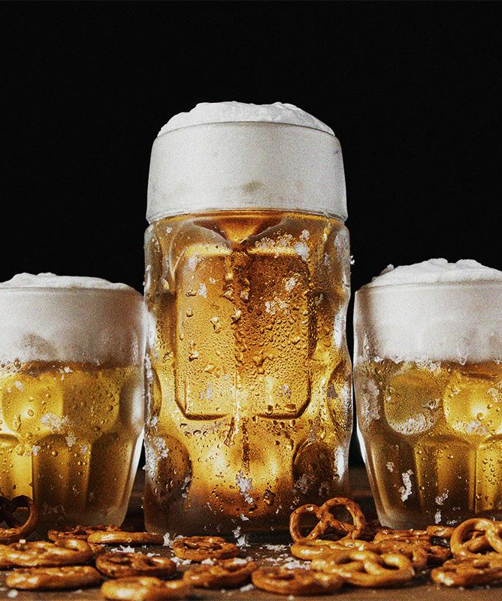
01
Introduction
CHEERS!
CHEERS!
CHEERS!

Slide 6
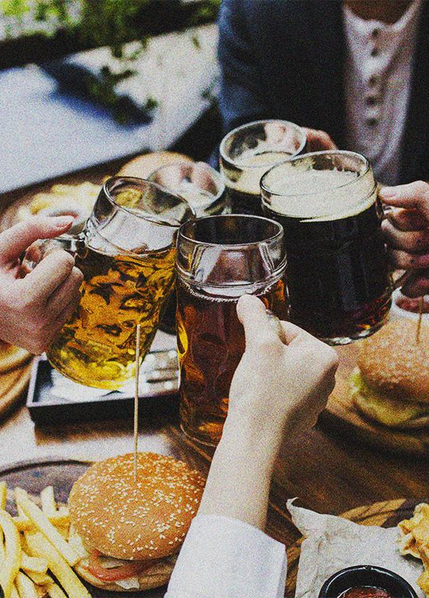
Imagine this: the annual consumption of beer by the average person is an astonishing 28.2 gallons. Yes, you read that right - 28.2 gallons! Now, picture a world where 500 different kinds of beer exist, each with its distinct flavour, style and brew.
CHEERS!
CHEERS!
CHEERS!

Slide 7

Data Set
CHEERS!
CHEERS!
'Beer Reviews from Beer Advocate'(Kaggle)
1.5 million observations of 13 different features obtained from 1996 to 2012
Beer Advocate, a blog site, is the source of the data that allows users to rate and review beers.
The aroma, appearance, palate, taste, and overall impressions of the beer are rated on a scale of 0 to 5 based on the user’s preferences.
User’s feedback on approximately 6,000 distinct breweries.
CHEERS!

Slide 8
Questions of Interest
Does alcohol content influence the overall beer rating? If yes, how?
Which beer styles consistently resonate with consumers?
What features significantly contribute to a beer's success as a brand?
Can we pinpoint factors leading to poor reception of a beer brand?

Slide 9
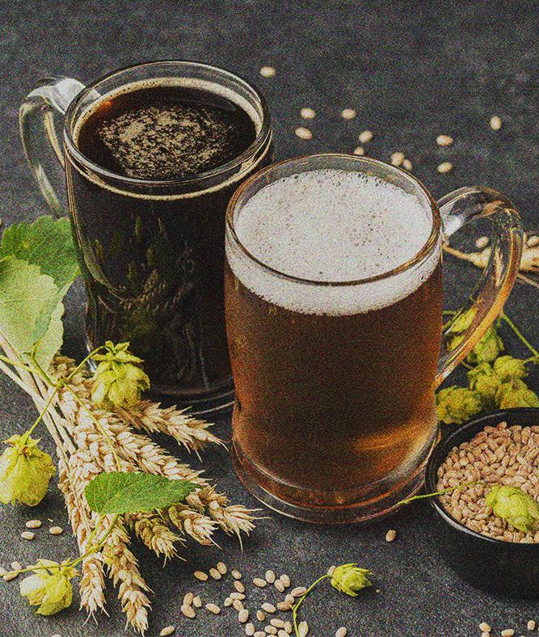
02
Data Processing
CHEERS!
CHEERS!
CHEERS!
Data Cleaning
Data Clustering

Slide 10
2.1 Data Cleaning
CHEERS!
CHEERS!
Check for null values
Treat missing values
Replacing missing 'brewery_name' and 'review_profilename' values with 'unknown'
Imputing for null values in 'beer_abv'
Correct the data type and format of 'review_time' column
Handle duplicate reviews
Take the latest review made by that person which would reflect their most recent take on the beer
CHEERS!

Slide 11
2.2 Processing for Clustering
1
2
3
Label encoding the categorical variables
Scaling numerical features
Determine number of clusters

Slide 12
Classifications
Quality of a beer:
Poor: Ratings below 3
Decent: Ratings between 3 and 4
Good: Ratings between 4 and 4.5
Best: Ratings of 4.5 and above
Alcohol Strength:
Low: Alcohol by volume (ABV) ranging from 0% to 5%
Mild: ABV between 5% and 15%
Strong: ABV between 15% and 30%
Extreme: ABV of 30% and above

Slide 13
Profiling of Clusters
Cluster 0
Cluster 1
Cluster 2
Cluster 3
3rd in overall, appearance, palate, taste scores
3rd in alcohol by volume %
Mostly consists of beers that can be considered decent
4th in overall, appearance, palate, taste scores
4th in alcohol by volume %
Mostly consists of beers that were considered poor
2nd in overall, appearance, palate, taste scores
2nd in alcohol by volume %
Well received by the consumers on average. High proportion of decent beers, brings average score down
1st in overall, appearance, palate, taste scores
1st in alcohol by volume %
These are beers that were most well received by the consumers on average

Slide 14
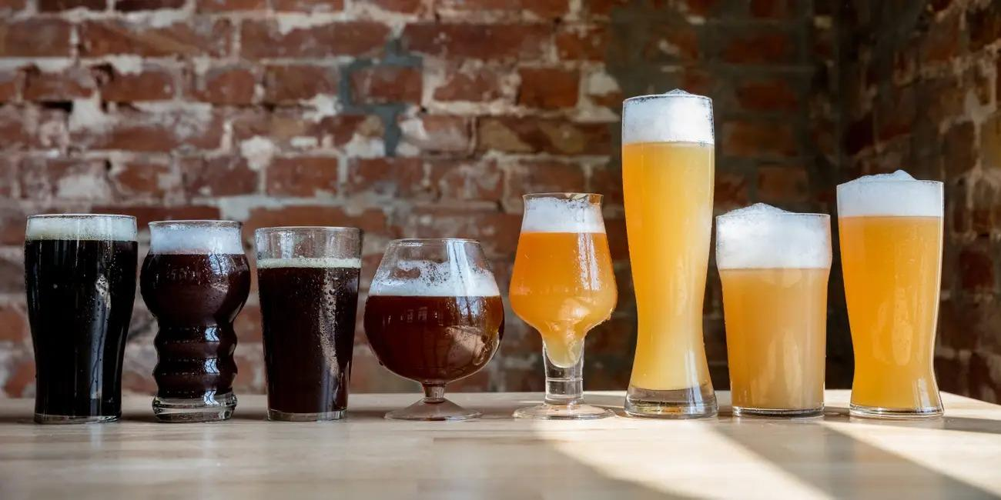
03
Data Analysis

Slide 15
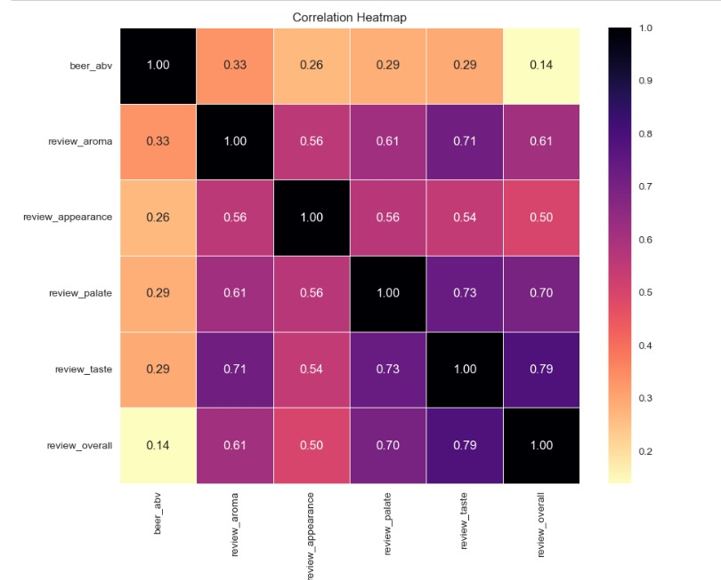
Correlation Heatmap

Slide 16
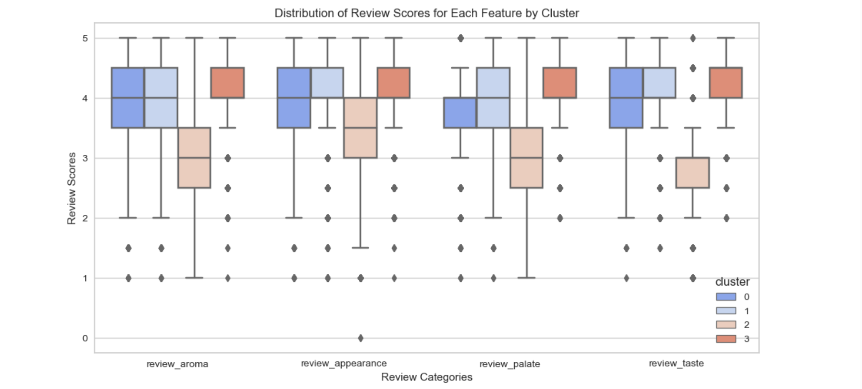
Distribution of Review Scores for Each Feature by Cluster
Notes:
By analyzing the distribution of review scores for each feature by cluster, the average review score for cluster 0 is around 4, the avearge review score for cluster 1 is 4, the average review score for cluster 2 is around 3, the avearge review score for cluster 3 is 4.
Therefore, cluster 2 leads to poor reception of a beer brand, which has the lowest avearge review score compared to the other 3 clusters.
From analyzing the 4 different review categories, we find that in those clusters, review_appearance and reveiw_taste have the high review scores compared to the other two.

Slide 17
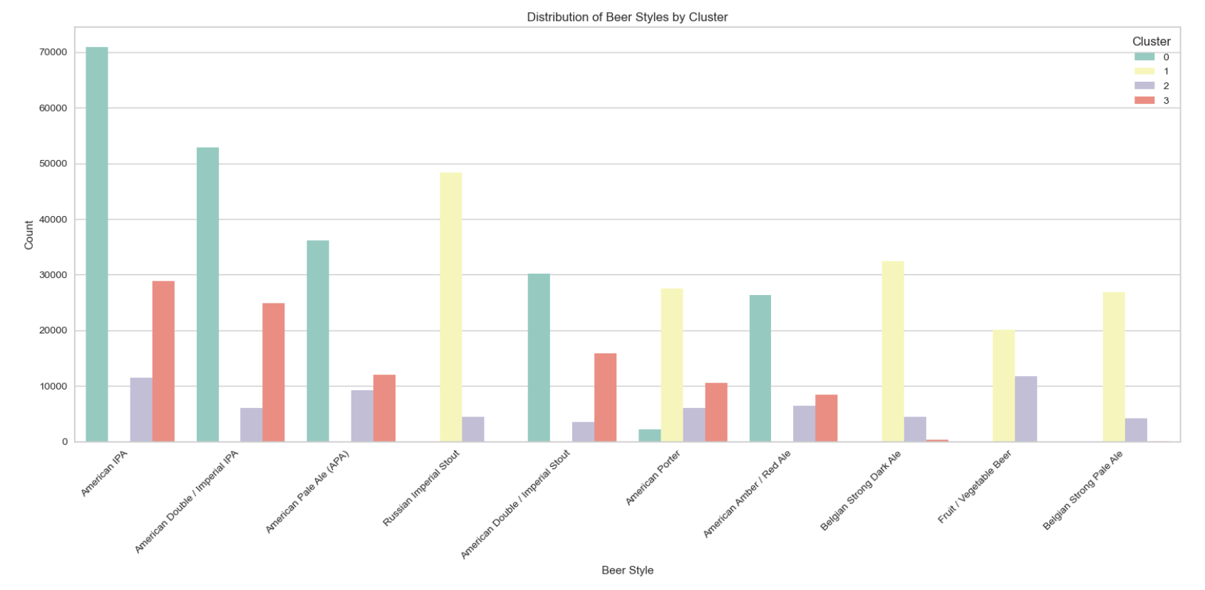
Distribution of Beer Styles by Cluster
Notes:
By analyzing the detailed beer style distribution by cluster, we found that the top 3
Upon looking at the graphs, we can observe that 'American IPA' and 'Fruit / Vegetable Beer' have the most presence in the 'infamous' cluster. But we can see that the former style has far greater presence in the better clusters as well. So much so that it dwarfs it's presence in the bad cluster. But for the latter, it's presence in the 'infamous' cluster is very significant.
Cluster 2 has the lowest average of numbers of reviews which is below 10k, which also demonstrated our conclusion that cluster 2 leads to poor reception of a beer styles.

Slide 18
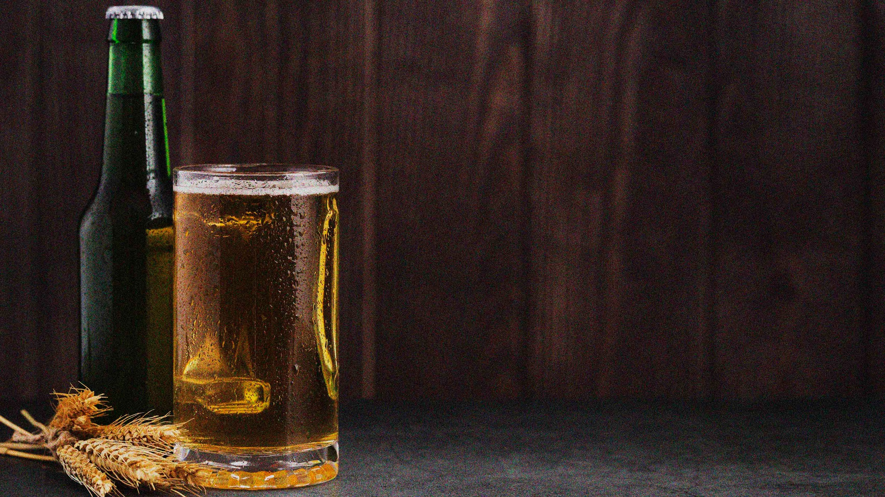
04
Conclusion
CHEERS!
CHEERS!
CHEERS!

Slide 19
Summary
Identify the extent to which each attribute of a beer affects its reception by consumers
Identify the beer styles that resonated consistently with them and how the characteristics varied across segments of beers
Provide insights regarding their success and failure in the market

Slide 20
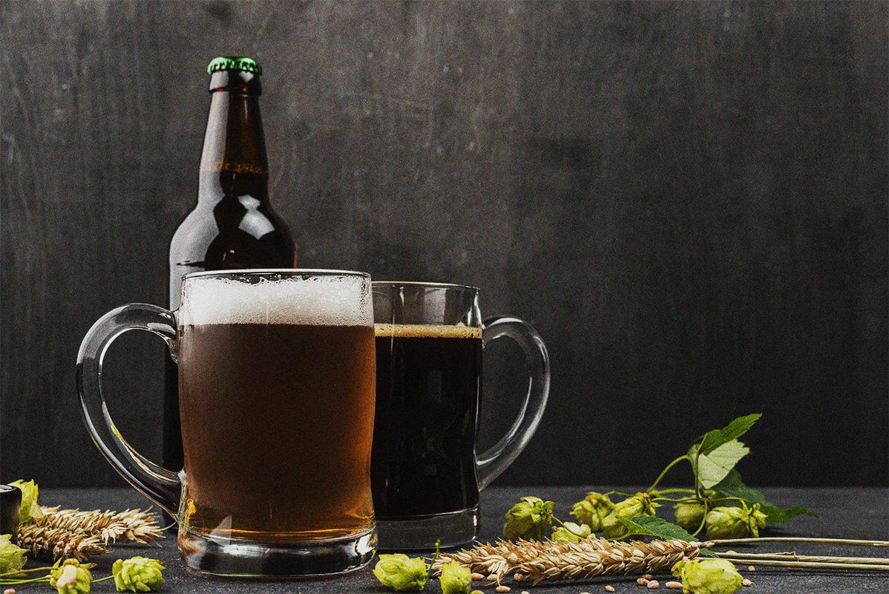
THANKS!
CHEERS!
CHEERS!
CHEERS!
QUESTIONS?

